Slide 1
Chapter 11
Language

Slide 2
What Is Language?
  System of communication using sounds or symbols
  Express feelings, thoughts, ideas, and experiences

Slide 3
The Creativity of Human Language
  Hierarchical system
  Components that can be combined to form larger units
  Governed by rules
  Specific ways components can be arranged
Notes:
Two key elements of language

Slide 4
The Universality of Language
  Deaf children invent sign language that is all their own
  All humans with normal capacities develop a language and learn to follow its complex rules

Slide 5
The Universality of Language
  Use of language is universal across cultures
  Language development is similar across cultures
  Languages are “unique but the same”
  Different words, sounds, and rules
  All have nouns, verbs, negatives, questions, past/present tense

Slide 6
Studying Language in Cognitive Psychology (1 of 2)
  B.F. Skinner (1957) Verbal Behavior
  Language learned through reinforcement
  Noam Chomsky (1957) Syntactic Structures
  Human language coded in the genes
  Underlying basis of all language is similar
  Children produce sentences they have never heard and that have never been reinforced

Slide 7
Studying Language in Cognitive Psychology (2 of 2)
  Psycholinguistics: discover psychological process by which humans acquire and process language
  Comprehension
  Speech production
  Representation
  Acquisition

Slide 8
Understanding Words
  Lexicon: all words a person understands
  Semantics: the meaning of language
  Lexical semantics: the meaning of words
  Each word has one or more meanings

Slide 9
Complications in Understanding Words (1 of 2)
  Word frequency effect
  We respond faster to high-frequency words
  Rayner and Duffy (1986) fixation and gaze times
  Eye movements while reading
  Look at low-frequency words longer
  Variable word pronunciation
  “Didjoo?” “Gonna”
  Use context to understand words with unfamiliar pronunciations

Slide 10
Complications in Understanding Words (2 of 2)
  Speech segmentation
  Perception of individual words even though there are no silences between spoken words
  Context
  Understanding of meaning
  Understanding of sound and syntactic rules
  Statistical learning

Slide 11
Understanding Ambiguous Words (1 of 2)
  Lexical ambiguity
  Words often have multiple meanings
  Lexical priming
  Tanenhaus (1979)
  People briefly access all meanings of a word before relying on context to determine accurate meaning

Slide 12
Understanding Ambiguous Words (2 of 2)
  Meaning dominance—some words are used more frequently than others
  Biased dominance
    When words have two or more meanings with different dominance
  Balanced dominance
    When words have two or more meanings with about the same dominance

Slide 13
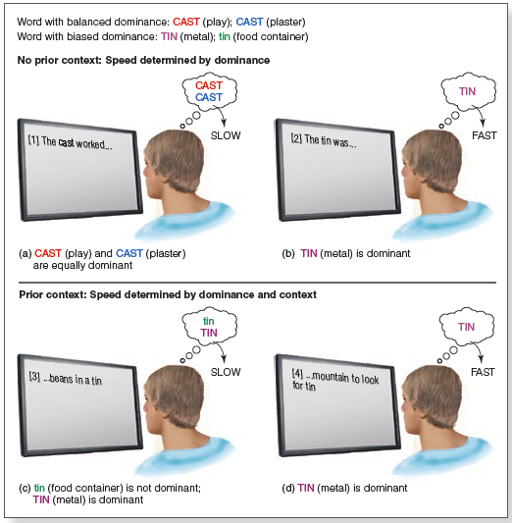
Meaning Dominance
Notes:
Figure 11.3 Accessing the meaning of ambiguous words while reading a sentence is determined by the word’s dominance and the context created by the sentence. If there is no prior context: (a) competition between equally likely meanings of a word with balanced dominance results in slow access; (b) activation of only the most frequent meaning of a word with biased dominance results in fast access. If there is context before a word with biased dominance: (c) activation of both the less frequent and most frequent meanings results in slow access; (d) activation of only the most frequent meaning results in fast access. See text for examples.

Slide 14
Understanding Sentences (1 of 4)
  Semantics: meanings of words and sentences
  Syntax: rules for combining words into sentences
  Sentences are merely strings of words in sequence
  Parsing: mentally groups the words into phrases
  helps the listener create meaning

Slide 15
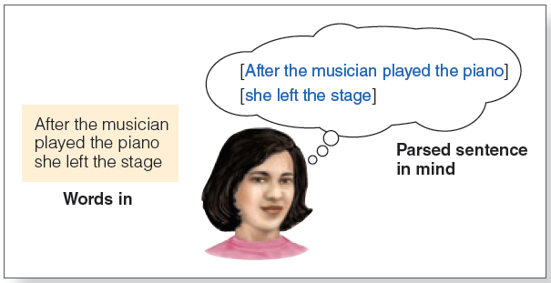
Understanding Sentences: Parsing
Notes:
Figure 11.4 Parsing is the process that occurs when a person hears or reads a string of words (Words in) and groups these words into phrases in their mind (Parsed sentence in mind). The way the words are grouped in this example indicates that the person has interpreted the sentence to mean that the musician played the piano and then left the stage.

Slide 16
Understanding Sentences (2 of 4)
  Garden path sentences
  Sentences that begin by appearing to mean one thing, but then end up meaning something else
  Temporary ambiguity
  When the initial words are ambiguous, but the meaning is made clear by the end of the sentence

Slide 17
Understanding Sentences (3 of 4)
  The garden path model of parsing
  Listeners use heuristics (rules) to group words into phrases
  Grammatical structure of sentence determines parsing
  Late closure: parser assumes new word is part of the current phrase

Slide 18
Understanding Sentences (4 of 4)
  Constraint-based approach to parsing combines:
  Syntax
  Word meaning
  Story context
  Memory load
    Subject-relative and object-relative sentence construction

Slide 19
Understanding Sentences: Story Context (1 of 3)
  Tanenhaus & Trueswell (1995)
  Visual world paradigm, the context of a scene
  Eye movements change when information suggests revision of interpretation of sentence is necessary
  Linguistic and nonlinguistic information used simultaneously

Slide 20
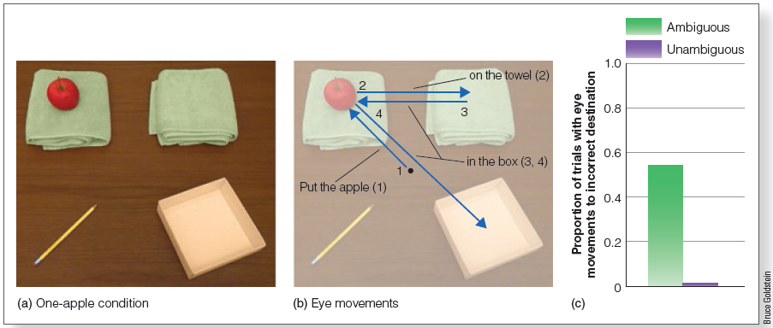
Understanding Sentences: Story Context (2 of 3)
Notes:
Figure 11.6 (a) One-apple scene similar to the one viewed by Tanenhaus et al.’s (1995) participants. (b) Eye movements made while comprehending the task. (c) Proportion of trials in which eye movements were made to the towel on the right for the ambiguous sentence. (Place the apple on the towel in the box) and the unambiguous sentence (Place the apple that’s on the towel in the box).

Slide 21
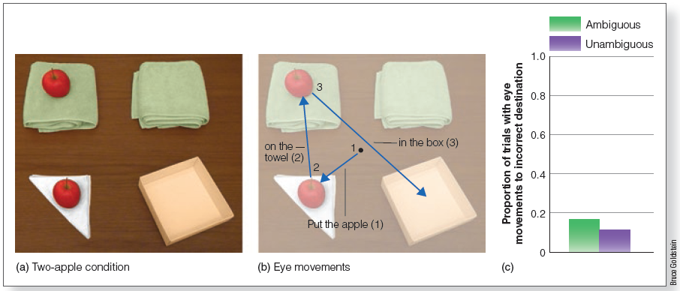
Understanding Sentences: Story Context (3 of 3)
Notes:
Figure 11.7 (a) Two-apple scene similar to the one viewed by Tanenhaus et al.’s (1995) subjects. (b) Eye movements while comprehending the task. (c) Proportion of trials in which eye movements were made to the towel on the right for the ambiguous sentence (Place the apple on the towel in the box) and the unambiguous sentence (Place the apple that’s on the towel in the box).

Slide 22
Understanding Text and Stories (1 of 6)
  Coherence:
  Representation of the text in one’s mind that creates clear relations…
    between parts of the text and
    between parts of the text and the story’s main topic

Slide 23
Understanding Text and Stories (2 of 6)
  Inference: readers create information during reading not explicitly stated in the text
  Anaphoric: connecting objects/people
  Instrument: tools or methods
  Causal: events in one clause caused by events in previous sentence

Slide 24
Understanding Text and Stories (3 of 6)
  Situation model: mental representation of what a text is about
  Represent events as if experiencing the situation
  Point of view of protagonist

Slide 25
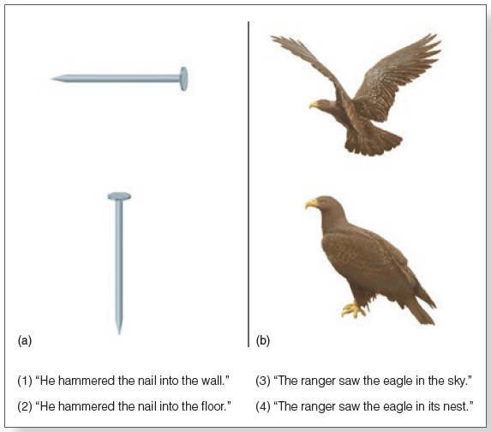
Understanding Text and Stories (4 of 6)
Notes:
Figure 11.9 Stimuli similar to those used in (a) Stanfield and Zwaan’s (2001) “orientation” experiment and (b) Zwaan et al.’s (2002) “shape” experiment. Subjects heard sentences and were then asked to indicate whether the picture was the object mentioned in the sentence

Slide 26
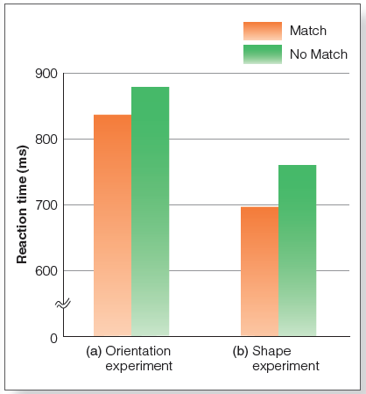
Understanding Text and Stories (5 of 6)
Notes:
Figure 11.10 Results of Stanfield and Zwaan’s (2001) and Zwaan et al.’s (2002) experiments. Subjects responded “yes” more rapidly for the orientation, in (a), and the shape, in (b), that was more consistent with the sentence.

Slide 27
Understanding Text and Stories (6 of 6)
  Physiology of simulations
  Approximately the same areas of the cortex are activated by actual movements and by reading related action words
  The activation is more extensive for actual movements

Slide 28
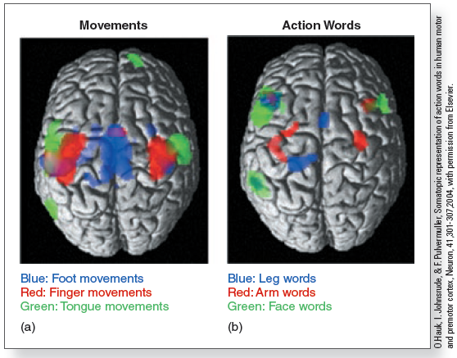
Situation Models and Brain Activation
Notes:
Figure 9.26 Hauk et al. (2004) results. Colored areas indicate the areas of the brain activated by (a) foot, finger, and tongue movements; (b) leg, arm, and face words.

Slide 29
Producing Language: Conversations
  Two or more people talking together
  Dynamic and rapid

Slide 30
Producing Speech: Conversations (1 of 3)
  Given–new contract: speaker constructs sentences so they include
  Given information
  New information
  “New” can then become “given” information
  Common ground
  Entrainment: synchronization between conversation partners

Slide 31
Producing Speech: Conversations (2 of 3)
  Syntactic coordination
  Using similar grammatical constructions
  Syntactic priming
  Production of a specific grammatical construction by one person increases chances other person will use that construction
  Reduces computational load in conversation

Slide 32
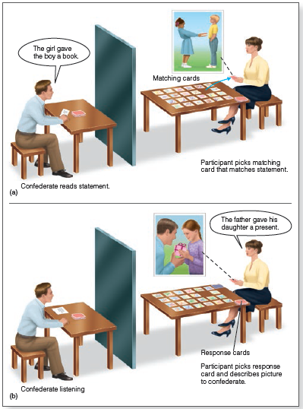
Syntactic Priming
Notes:
Figure 11.14 The Branigan et al. (2000) experiment. (a) The subject (right) picks, from the cards laid out on the table, a card with a picture that matches the statement read by the confederate (left). (b) The participant then takes a card from the pile of response cards and describes the picture on the response card to the confederate. This is the key part of the experiment, because the question is whether the participant on the right will match the syntactic construction used by the confederate on the left.

Slide 33
Producing Speech: Conversations (3 of 3)
  Other skills are necessary for people to engage in effective conversations.
  Theory of mind: being able to understand what others feel, think, or believe
  Nonverbal communication: being able to interpret and react to the person’s gestures, facial expressions, tones of voice, and other cues to meaning

Slide 34
Music and Language
  Prosody: the pattern of intonation and rhythm in spoken language
  Often creates emotion in spoken language (a speaker’s “soaring oratory”)
  Music as the “language of emotion”
  Music creates emotion through sounds that have no meaning
  Language combines words and music combines tones to create structured sequences that unfold over time.

